Slide 1
Eskwelabs Capstone
Project
Getting to Know Your Borrower
by Mike Allan Nillo
Notes:
Did you ever wonder who your real customers are?
Or had you ever had a dilemma which customers to target for your product?
Lucky you, I will talk about the power of customer segmentation in the context of loan approval using Home Credit dataset

Slide 2


Who’d You Rather?
JAKE PERALTA
CHARLES BOYLE
Male
Young below 25
Literally, forever in debt
Have an unstable income
Male
Old, but mature
No house
Food blogger / office staff
Notes:
Let us play a game, who’d you rather?
Introducing borrower #1, blah blah OR
Introducing borrower #2

Slide 3

Two Critical Segmentation Questions
What is the main driver of a borrower getting approved or rejected?
Who are the existing borrowers and how can we maximized them?
Notes:
Keep the answers to yourselves, and make sure to consider these 2 critical questions:
What is the main driver…
Who are your existing borrowers and how can we maximize them?

Slide 4
Three Stages of Knowing Your Borrowers
PAYMENT PATTERNS
CLUSTERS
MARKETING
GETTING-TO-KNOW YOUR BORROWERS
STARTER PACK
Notes:
This is my propose strategy to get to know your borrower:
First, get to know the borrower’s payment patterns, next organize them with clusters, and turn those clusters into actions by incorporating marketing strategies to them

Slide 5


Do Your Background Checks!
PAYMENT PATTERNS CLUSTERS MARKETING
POS CASH BALANCE
Months balance Recency
Count of transactions Frequency
CREDIT CARD BALANCE
Amount payments Monetary
Count withdraws Frequency
INSTALLMENT PAYMENTS
Days installment Recency
Amount installment Monetary
LOAN APPROVAL
LOGISTIC REGRESSION
Accuracy: 51.7%
Precision: 51.9%
Recall: 57.5%
RANDOM FOREST
Accuracy: 92.5%
Precision: 97.7%
Recall: 87.3%
XGBOOST
Accuracy: 94.5%
Precision: 93.3%
Recall: 90.5%
Notes:
Let’s go to the first step of your getting-to-know your borrowers starter pack:
We all should do our background checks by considering the previous transactions, your borrower had. I considered recency, frequency and monetary value of their loan payment transactions to predict what is the main predictor of approval of a loan.
Beside it, we see the accuracy, precision and recall of the three algorithms I used to predict the approval of a loan

Slide 6

Quality over Quantity
INSIGHT
PAYMENT PATTERNS CLUSTERS MARKETING
ORIGINAL
Get the largest amount of loans for more interest
REVISED
Possibility of delays should be minimized
Notes:
…And the result is:
Not to get the customers with the largest loan amount so we can have the largest interest.
But we should focus on the minimizing the possibility of delays of a borrower.

Slide 7
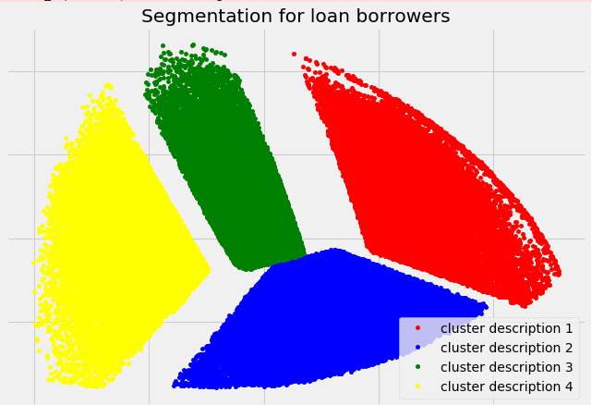
“Tell Me Your Friends And I will Tell You Who You Are”
PAYMENT PATTERNS CLUSTERS MARKETING
Notes:
Next, we group them borrowers that had the same payment patterns, gender, source of income and assets/collateral. This is what it looks like when we group them;

Slide 8

What To Look For…?
INSIGHT
PAYMENT PATTERNS CLUSTERS MARKETING
DEMOGRAPHIC
ABILITY TO PAY
ASSETS (COLLATERAL)
Notes:
So based on our clusters, what should we look for a borrower? To have a good payment pattern or by minimizing the number of delays, the borrowers should have a stable source of income to be able to pay off their debts on time

Slide 9
INSIGHT
Be Wary of Them!
Average Borrower
Mid-External Source of Income
Male and Female
Mostly Pensioner income type
PAYMENT PATTERNS CLUSTERS MARKETING
Notes:
Translating them into marketing actionable insights, first we should be wary of this guy:
He is the usual borrower and is mostly our customer, but we forgot that he had an unstable income. We should maximize the number of weeks he can pay without any delays, and offer it to him.

Slide 10
Give Them A Chance…
INSIGHT
High Loaner
High External Source of Income
Male and Female
Mostly staff occupation type
PAYMENT PATTERNS CLUSTERS MARKETING
Notes:
This guy over here deserves a second chance. We might be discouraged by his demands of high amount of loan, but we forgot that he had a stable income and had a high external source of income. We should offer him a more flexible payment terms so I suggest getting the highest amount of loan where he would not be able to miss a payment.

Slide 11


Treasure them
INSIGHT
PAYMENT PATTERNS CLUSTERS MARKETING
Low Spending, Loyal Borrowers
Mixed of low and high source of income
Mixed composition of gender
Upper-level occupation type (managerial and tech staff)
Notes:
Last but not the least, our loyal borrowers. We might give them some incentives to spend, but the fact that they already had a lot of transactions with us is enough to keep them.

Slide 12
Machine Learning <> Marketing
INSIGHT
PAYMENT PATTERNS CLUSTERS MARKETING
Borrowers with lowest delay and highest ability to pay should be prioritized. Beware of average borrowers, give some chance the high loaner and treasure our loyal borrowers
DAY 1-30
Experiment via A/B tests
DAY 20-50
Evaluate results
DAY 20-70
Build outlier detection system
DAY 45 onwards
Maintain and add more data…

Slide 13

THANK YOU!

Slide 14
Appendix: Specific Steps
Data Cleaning
1. More logical feature engineering that reflects the payment patterns (RFM, cohorts/segments, groupby aggregation function)
2. Balancing the dataset
3. Transforming and normalizing the dataset according to the assumptions of the algorithms that I will use
4. Cross validation and parameter tuning for the machine learning algorithms
Unsupervised Clustering
- Age, Gender, Family Status DEMOGRAPHIC - Income Source, Occupation Type, External Source ABILITY TO PAY - Car Ownership, Home Ownership ASSETS

Slide 15
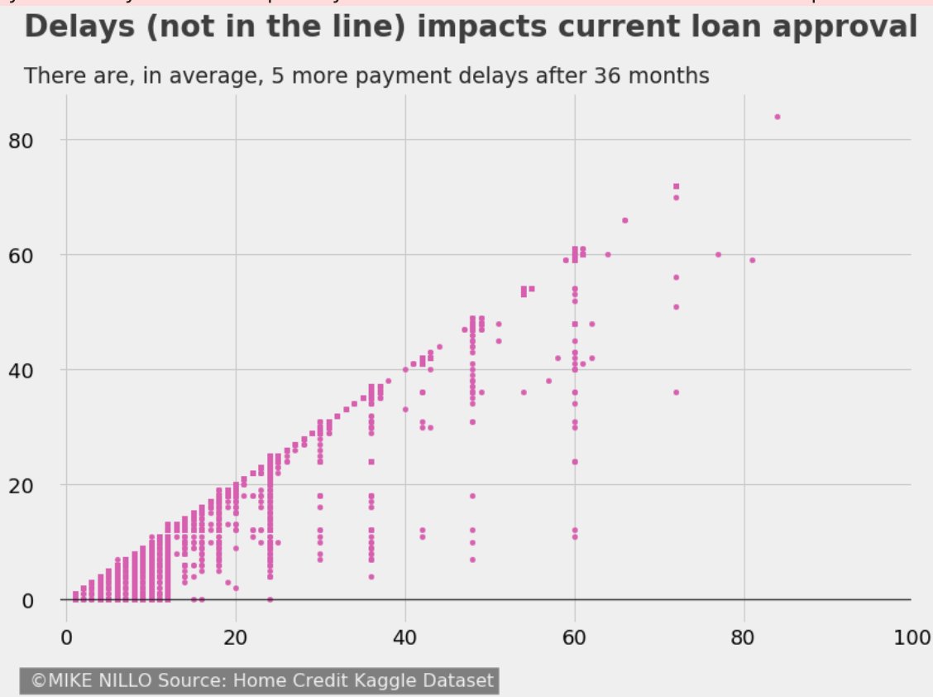
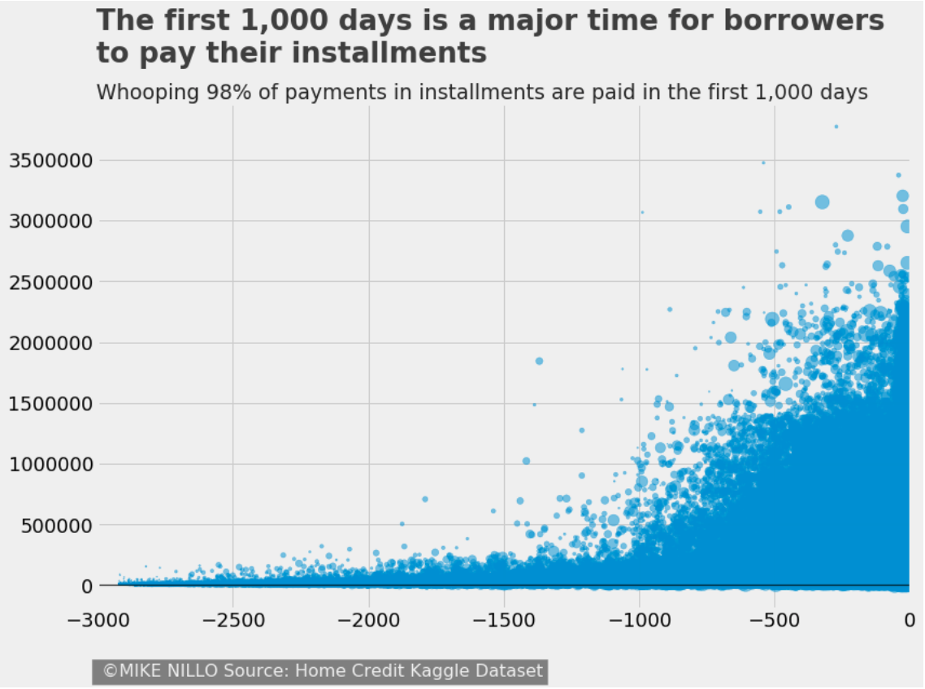
Appendix: EDA

Slide 16
Appendix: Supervised Learning Algorithms
Logistic Regression
Accuracy: 51.7%
Precision: 51.9%
Recall: 57.5%
F1: 54.6%
Random Forest
Accuracy: 92.5%
Precision: 97.7%
Recall: 87.3%
F1: 92.2%
XGBoost
Accuracy: 94.5%
Precision:
Recall:
F1:

